Slide 1

Java OOP and Data Structures with Introduction to Secure Coding Dr. Ziping Liu
Chapter 1 Arrays

Slide 2
https://he.kendallhunt.com/product/java-oop-and-data-structures-introduction-secure-coding
Chapter 1 Arrays

Slide 3

Chapter Outlines
Creating an array
Indexing an array
Performing operations with the elements of an array
Writing methods with arrays as parameters
Processing strings with arrays
Dealing with 2-D arrays

Slide 4
1.1 Creating an Array
an array is like a list, with one element stored in each slot.
The length of an array is fixed.
Each of the elements in the array must be of the same type.
Creating an array:
Syntax: naming and creating 1-d array
type[] nameOfArray = new type[length];
Syntax: splitting 1-d array naming and creation
type[] nameOfArray; nameOfArray = new type[length];

Slide 5
1.2 Indexing an Array
Indexing an array:
Syntax: indexing an array
nameOfArray[index]
Syntax: getting the length of an array
nameOfArray.length

Slide 6
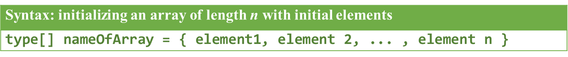
1.3 Performing operations with the elements of an array

Slide 7
1.4 Writing methods with arrays as parameters
In Java, parameters are passed by value.
Core Concept: Java parameters are passed by value into methods.
Primitives enter methods as copies of the original values. The method will NOT modify the original value.
Objects enter methods as copies of the reference to the object in the heap. The method CAN modify the original object.

Slide 8
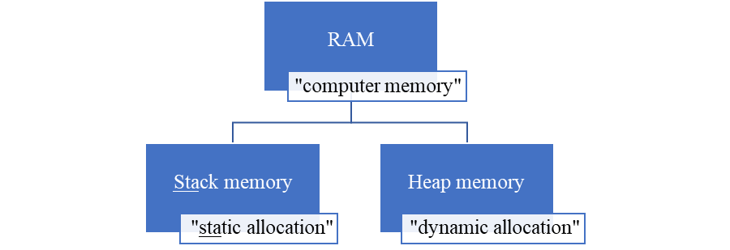
1.4 Writing methods with arrays as parameters
Figure 1-1 Types of computer memory

Slide 9
1.4 Writing methods with arrays as parameters
Syntax: for-each loops
for (type elementName: nameOfArray) { // do something with elementName }

Slide 10
1.5 Processing strings with arrays
We can work with Strings in the same iterative manner as we do with arrays.
Syntax: getting the length of a String
nameOfString.length()
Syntax: accessing one character of a String
nameOfString.charAt(index)
Syntax: splitting a String into “words”
nameOfString.split(delimiterToSplitOn)

Slide 11
1.6 Working with 2-D arrays
If we have “tabular,” or multiple rows of data, we can use a 2-D array.
Syntax: naming and creating a rectangular 2-d array
type[][] nameOfArray = new type[rowLength][columnLength];
Syntax: naming and creating a jagged 2-d array
type[][] nameOfArray = new type[rowLength][];

Slide 12
1.6 Working with 2-D arrays
Syntax: accessing an element of a 2-d array
nameOfArray[rowIndex][columnIndex]
For a jagged 2-D array, within each “row” iteration, we determined the column length of that row by setting:
int jlen = arr[i].length;

